Slide 1
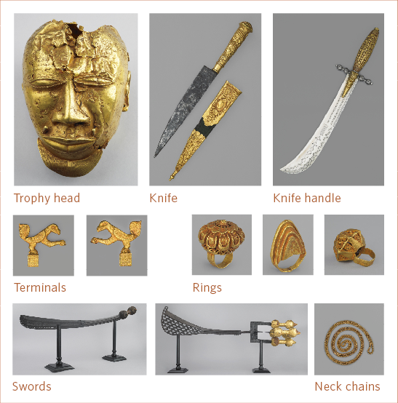
ASANTE GOLD
AND HISTORY AT THE WALLACE COLLECTION
KEY WORKS
Asante society has always dealt with gold. The precious metal plays a significant role in the symbolic representation of the unity of the kingdom. From its inception, Asante is believed to have been united through the power of the Golden Stool – a royal throne that is both the essence of the kingdom and the mark of the Asantehene (the king). It was considered so powerful that not even the Asantehene himself could sit on it. Together, the Golden Stool and the Gold Elephant Tail, sika mena, form the twin-symbol of the authority of the Asantehene. In state ceremonies, the Asantehene’s procession was always preceded by apem nnaka, chests of wealth, which were carried by his topmost attendants. This close association demonstrated that the Asantehene always had access to sika (gold), and could handle emergencies, even those that arose during state events.

Slide 2
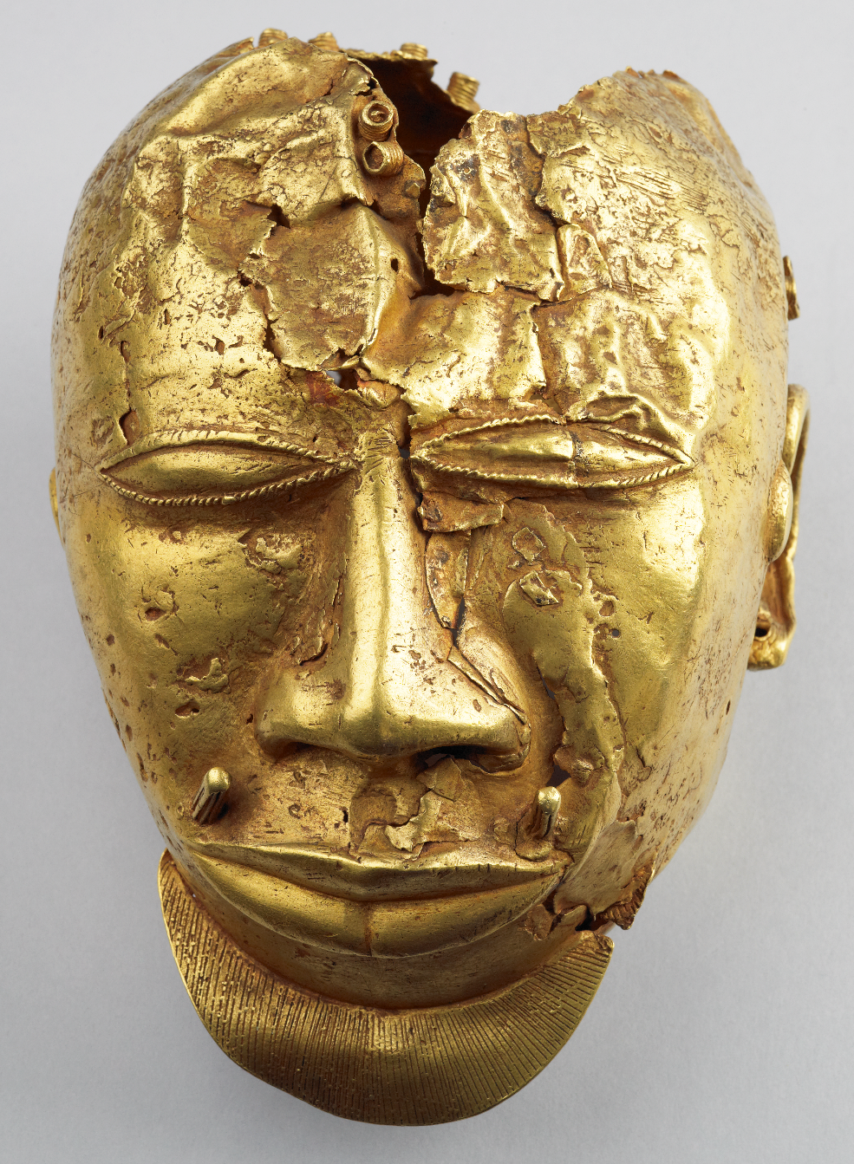
ASANTE GOLD
^{TROPHY HEAD}
AT THE WALLACE COLLECTION
The trophy head probably depicts a decapitated high-status enemy. Such heads would have been attached to ceremonial swords. State swords belonged to Asante regalia – objects owned by the state and intended for public display.
The Asante employed different sword ornaments, including gold heads, often called ‘heads of Worosa’. Worosa was a chief of the northern Banda state who, reputedly, was assassinated by Asantehene (king of Asante) Osei Kwadwo for killing Asante traders, possibly around 1765. The first casting of Worosa’s head was probably made soon after, and more representations followed. Given its wear and damage, the head in the Wallace Collection might have been an early cast.
^{DATE}
^{SIZE}
^{MATERIAL}
^{MAKER}
^{PLACE}
^{18th or 19th Century}
^{Height: 20 cm}
^{Width: 14.5 cm}
^{Depth: 14 cm}
^{Weight: 1.36 kg}
^{Gold}
^{Unknown}
^{Asante (present day Ghana)}

Slide 3
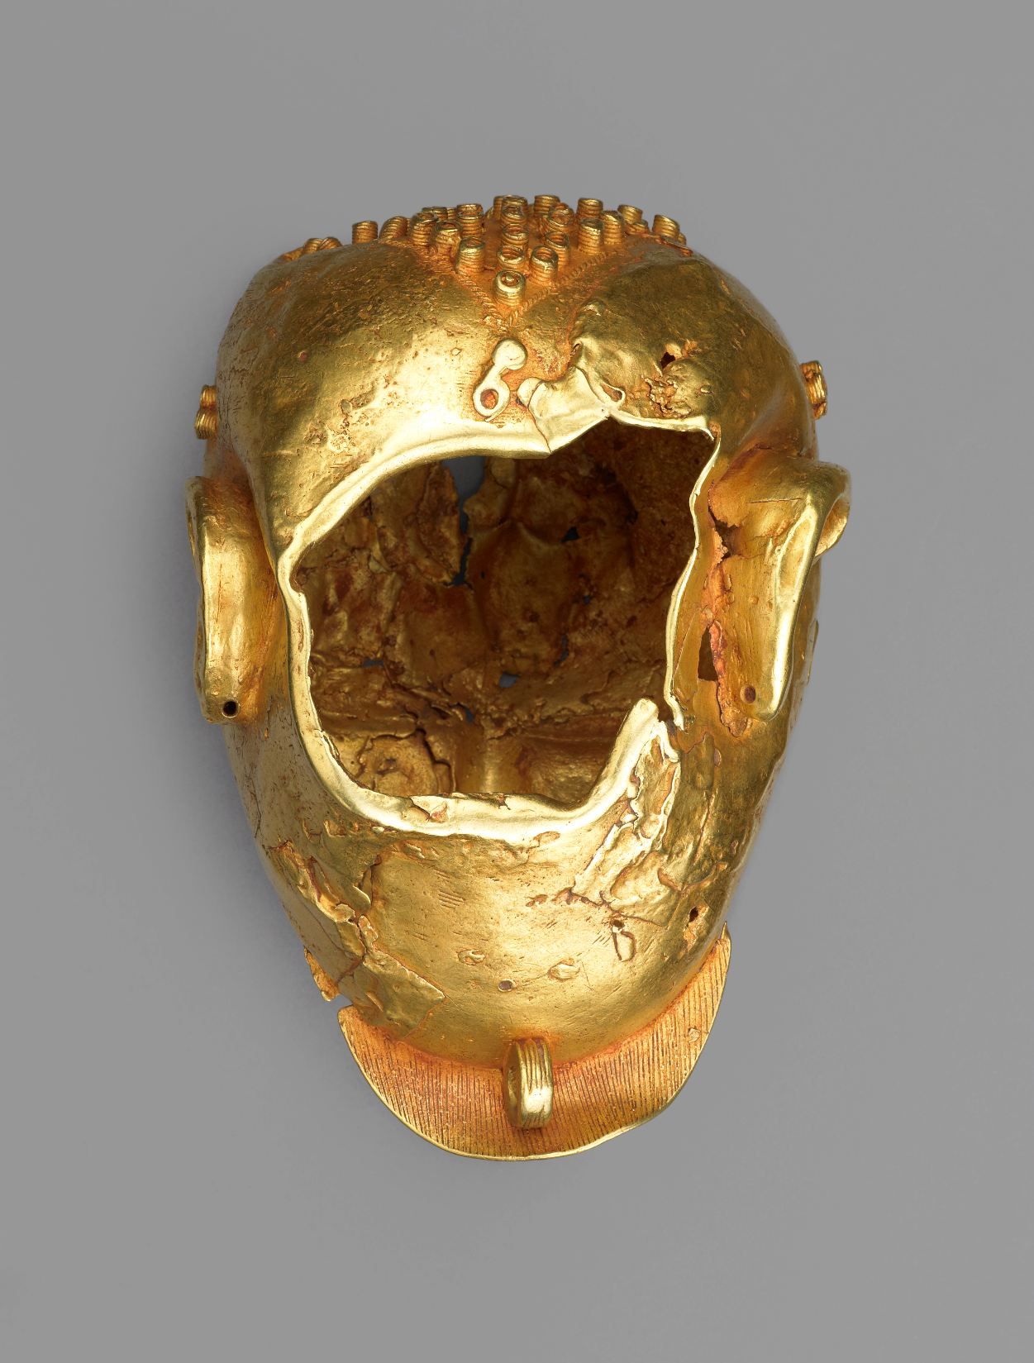
ASANTE GOLD
^{TROPHY HEAD}
AT THE WALLACE COLLECTION

Slide 4
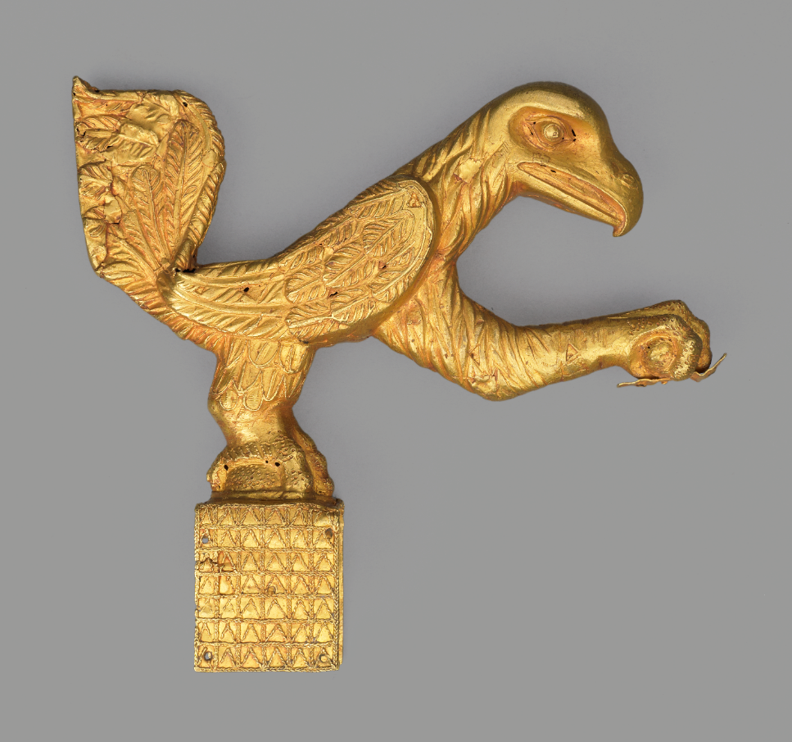
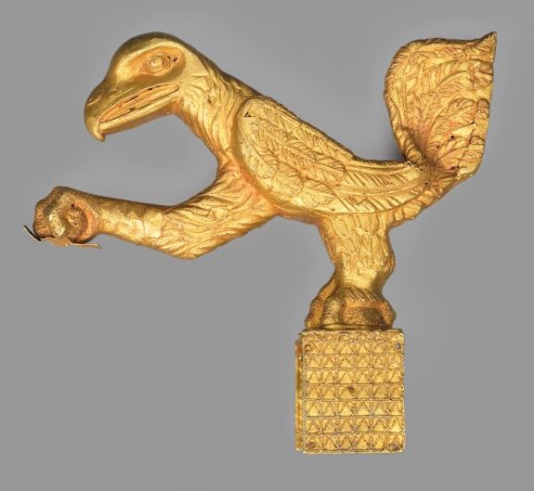
ASANTE GOLD
^{FINIALS}
AT THE WALLACE COLLECTION
^{DATE}
^{SIZE}
^{MATERIAL}
^{MAKER}
^{PLACE}
^{Height: 16.3 cm}
^{Length: 18.5 cm}
^{Width: 3.8 cm}
^{Gold}
^{Unknown}
^{Asante}
^{(present day Ghana)}

Slide 5
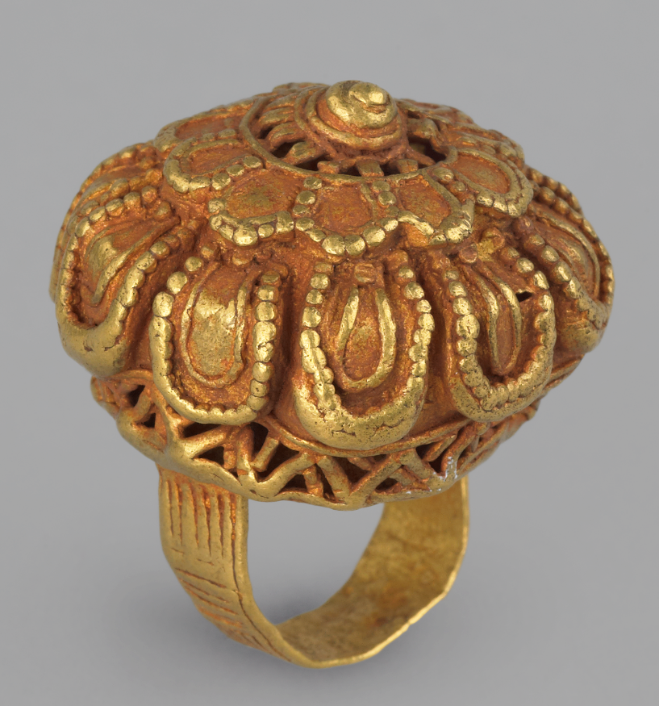
ASANTE GOLD
^{FINGER RING}
AT THE WALLACE COLLECTION
^{DATE}
^{SIZE}
^{MATERIAL}
^{MAKER}
^{PLACE}
^{19th century}
^{Diameter: 2.9 cm}
^{Height: 3.2 cm}
^{Gold}
^{Unknown}
^{Asante (present day Ghana)}

Slide 6
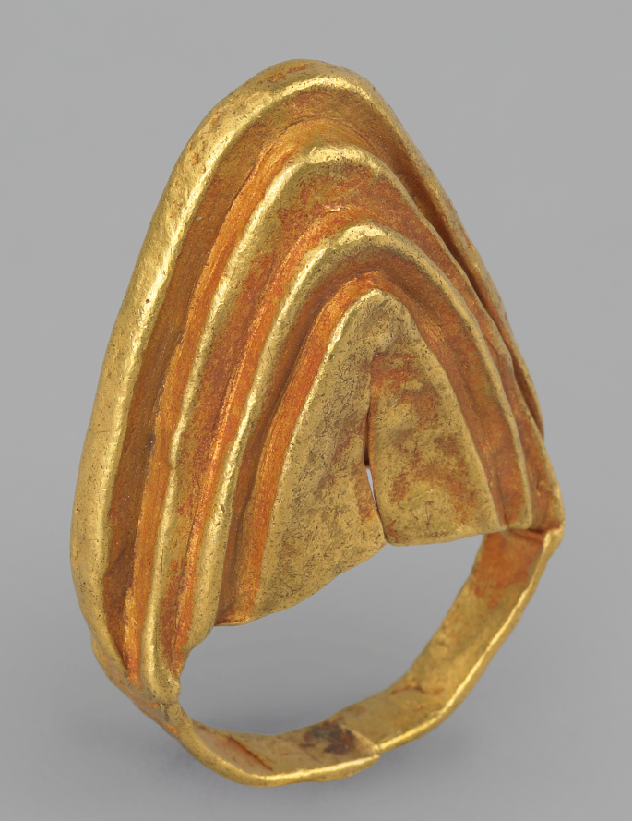
ASANTE GOLD
^{FINGER RING}
AT THE WALLACE COLLECTION
^{DATE}
^{SIZE}
^{MATERIAL}
^{MAKER}
^{PLACE}
^{Height: 4.5 cm}
^{Width: 3 cm}
^{Length: 1.1 cm}
^{Gold}
^{Unknown}
^{Asante}
^{(present day Ghana)}

Slide 7
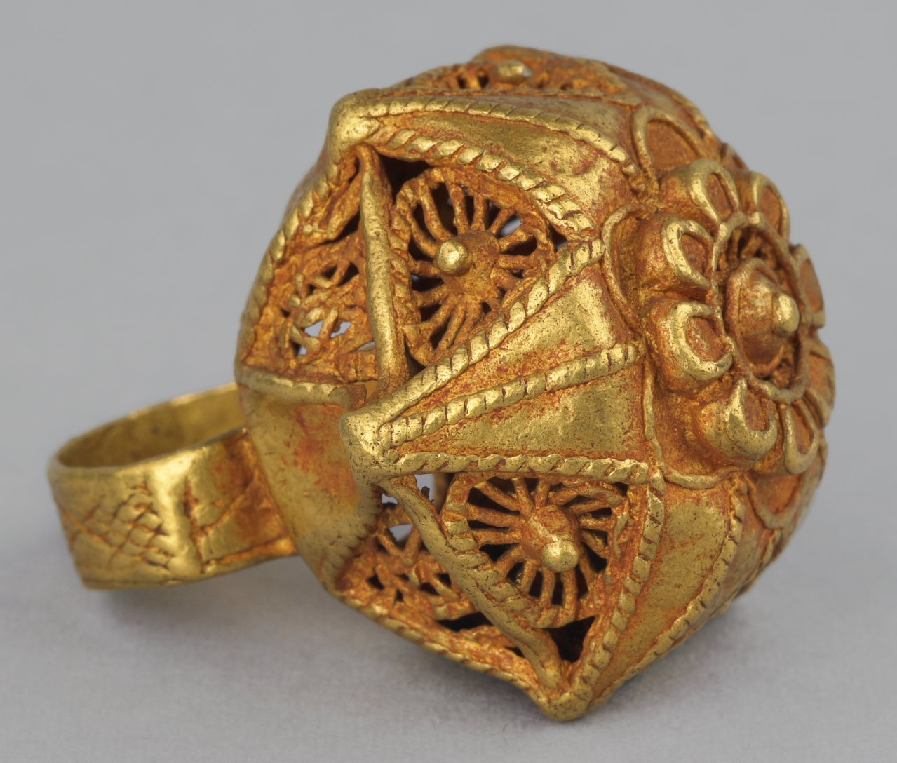
ASANTE GOLD
^{FINGER RING}
AT THE WALLACE COLLECTION
^{DATE}
^{SIZE}
^{MATERIAL}
^{MAKER}
^{PLACE}
^{Height: 4.5 cm}
^{Width: 3 cm}
^{Length: 1.1 cm}
^{Gold}
^{Unknown}
^{Asante}
^{(present day Ghana)}

Slide 8
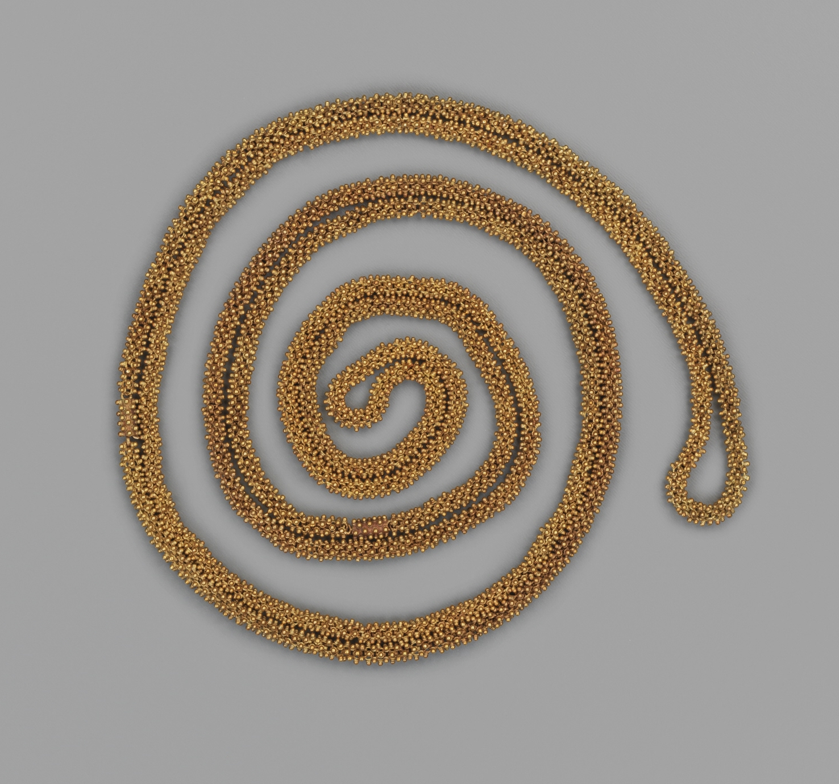
ASANTE GOLD
^{NECK CHAIN}
AT THE WALLACE COLLECTION
^{DATE}
^{SIZE}
^{MATERIAL}
^{MAKER}
^{PLACE}
^{19th century}
^{110 cm length}
^{Gold}
^{Unknown}
^{Asante}
^{(present day Ghana)}

Slide 9
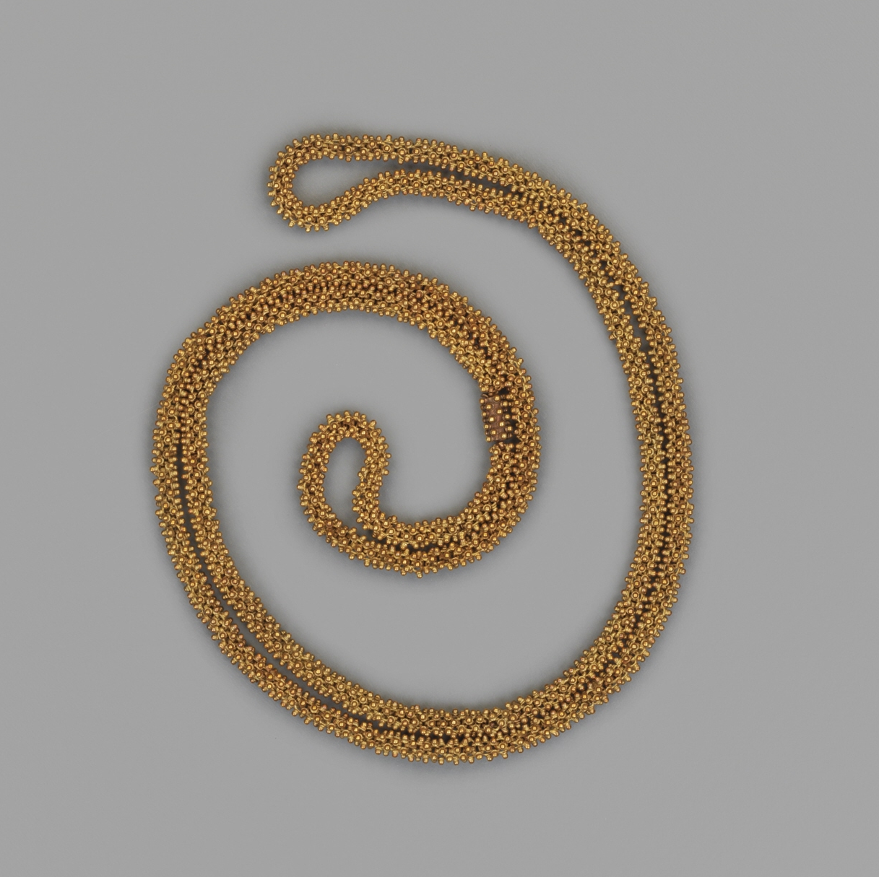
ASANTE GOLD
^{NECK CHAIN}
AT THE WALLACE COLLECTION
^{DATE}
^{SIZE}
^{MATERIAL}
^{MAKER}
^{PLACE}
^{19th century}
^{54.5 cm length}
^{Gold}
^{Unknown}
^{Asante}
^{(present day Ghana)}

Slide 10
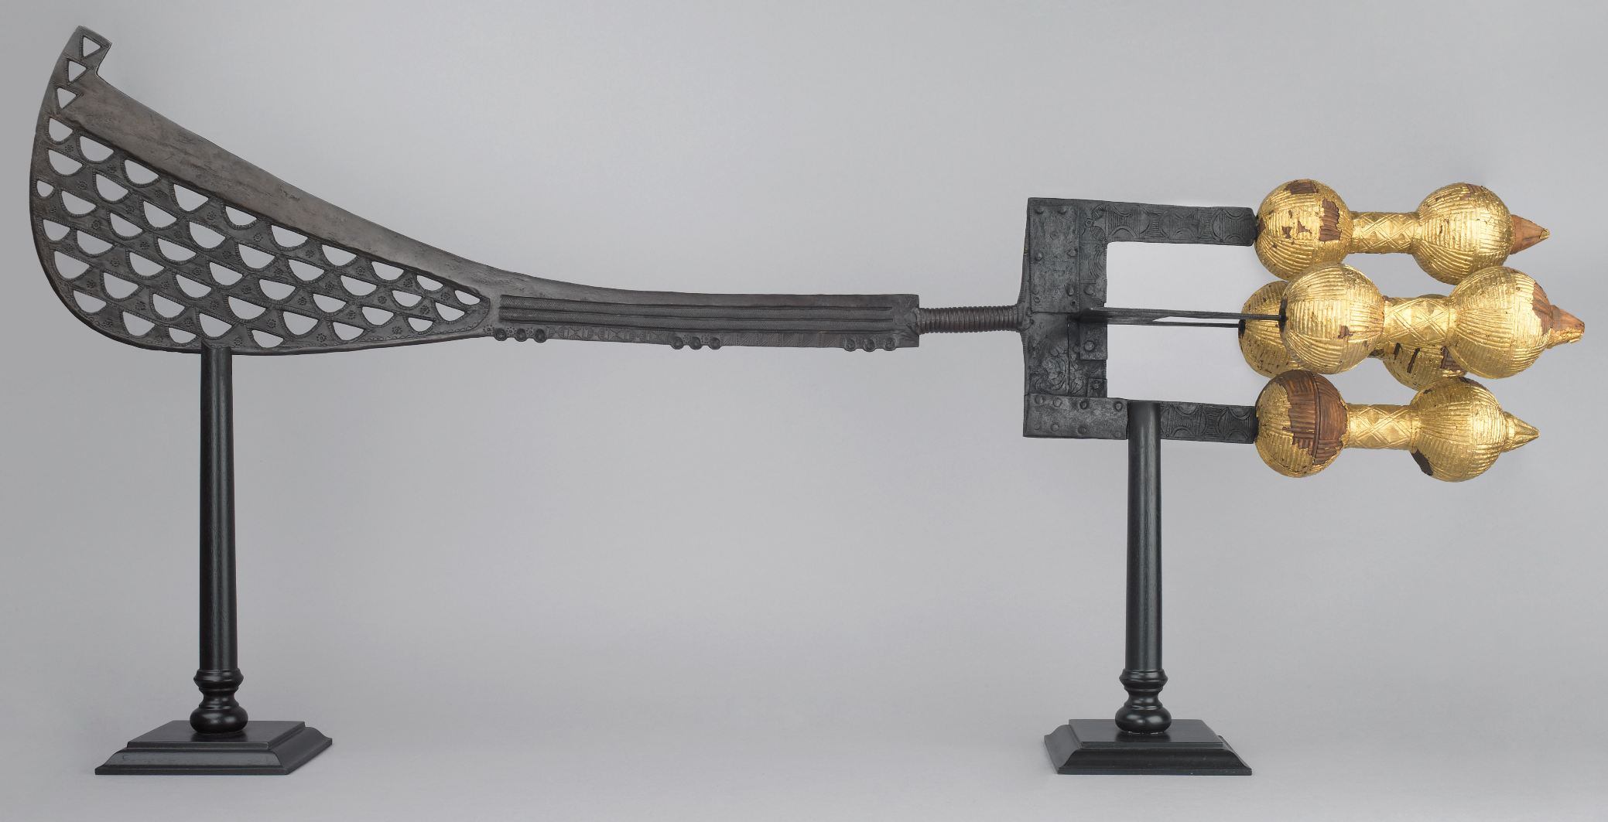
ASANTE GOLD
^{SWORD}
AT THE WALLACE COLLECTION
^{DATE}
^{SIZE}
^{MATERIAL}
^{MAKER}
^{PLACE}
^{19th century}
^{Length: 118 cm}
^{Gold and wood}
^{Unknown}
^{Asante (present day Ghana)}

Slide 11
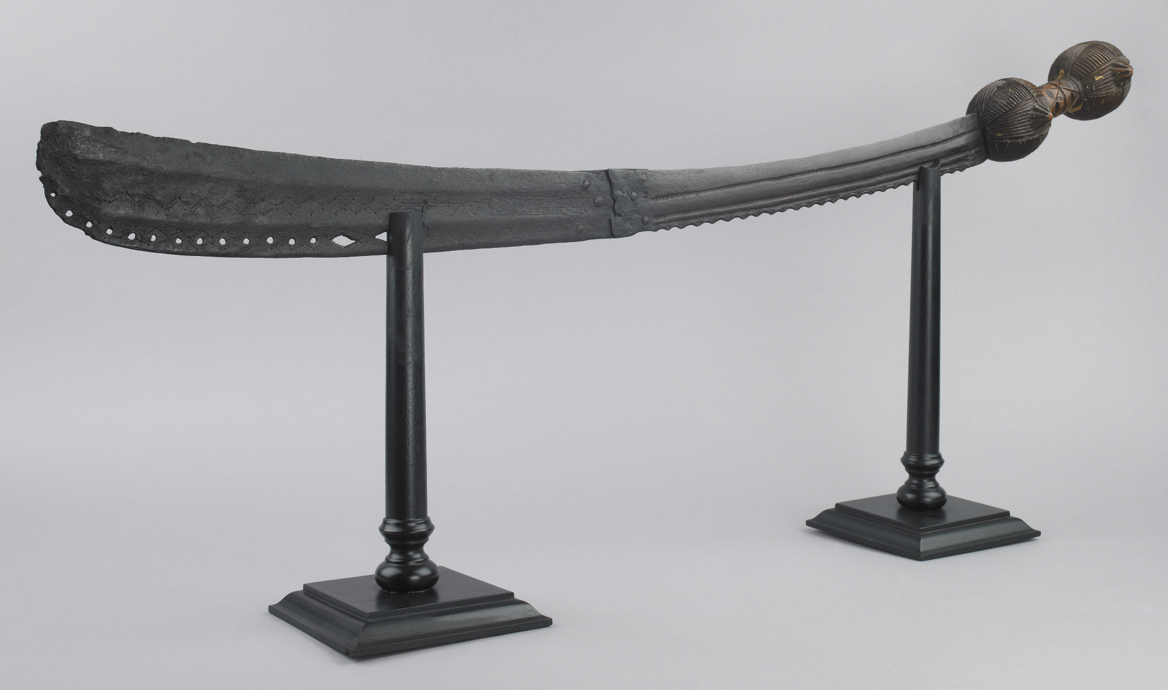
ASANTE GOLD
^{SWORD}
AT THE WALLACE COLLECTION
^{DATE}
^{SIZE}
^{MATERIAL}
^{MAKER}
^{PLACE}
^{19th century}
^{Length: 81.2 cm, blade}
Gold, russet iron and wood, incised
^{Unknown}
^{Asante (present day Ghana)}

Slide 12
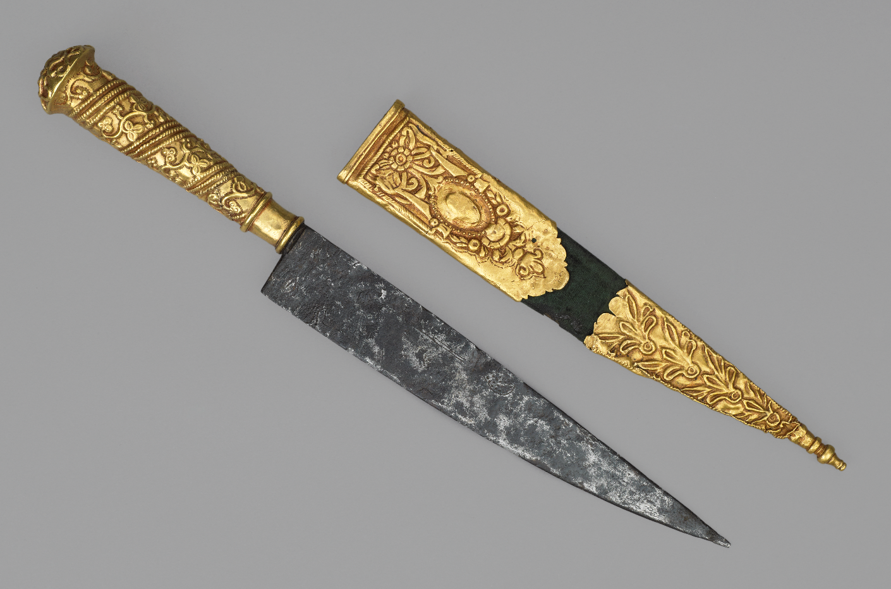
ASANTE GOLD
^{KNIFE WITH SCABBARD}
AT THE WALLACE COLLECTION
^{DATE}
^{SIZE}
^{MATERIAL}
^{MAKER}
^{PLACE}
^{19th century}
^{Length: 32 cm, width: 3.7 cm}
^{Gold and iron, incised}
^{Unknown}
^{Asante}
^{(present day Ghana)}

Slide 13
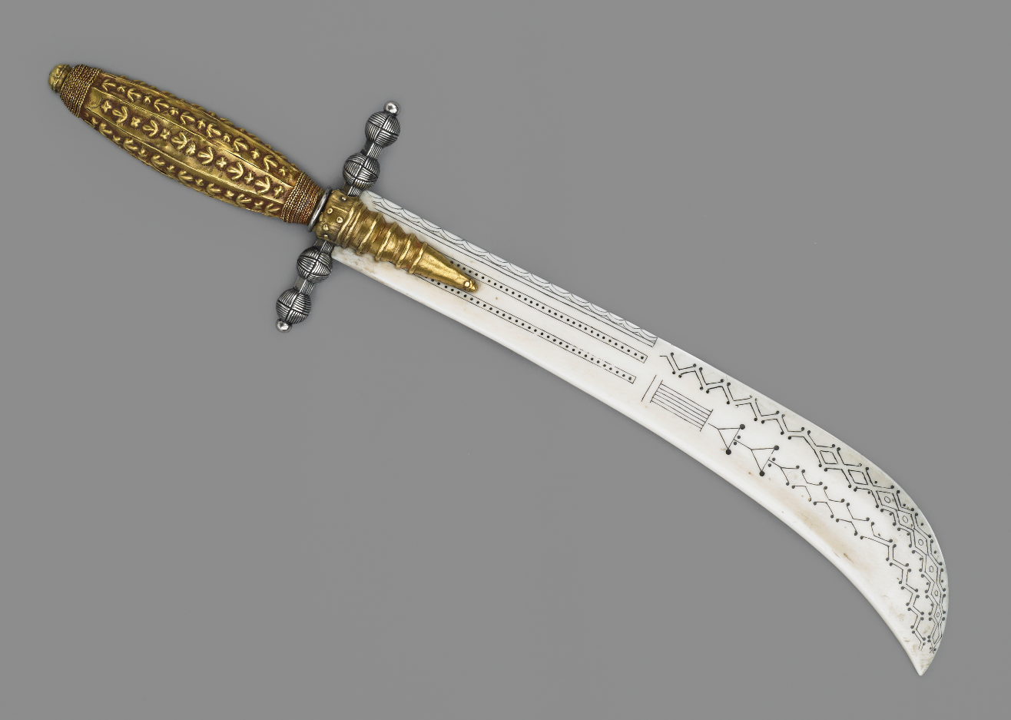
ASANTE GOLD
^{KNIFE HANDLE}
AT THE WALLACE COLLECTION
Two large Asante gold beads incorporated into a paper knife with an ivory blade.
^{DATE}
^{SIZE}
^{MATERIAL}
^{MAKER}
^{PLACE}
^{19th century}
^{Length 31 cm, width 7.6 cm}
^{Gold and iron, incised}
^{Unknown}
^{Asante}
^{(present day Ghana)}

